Slide 1
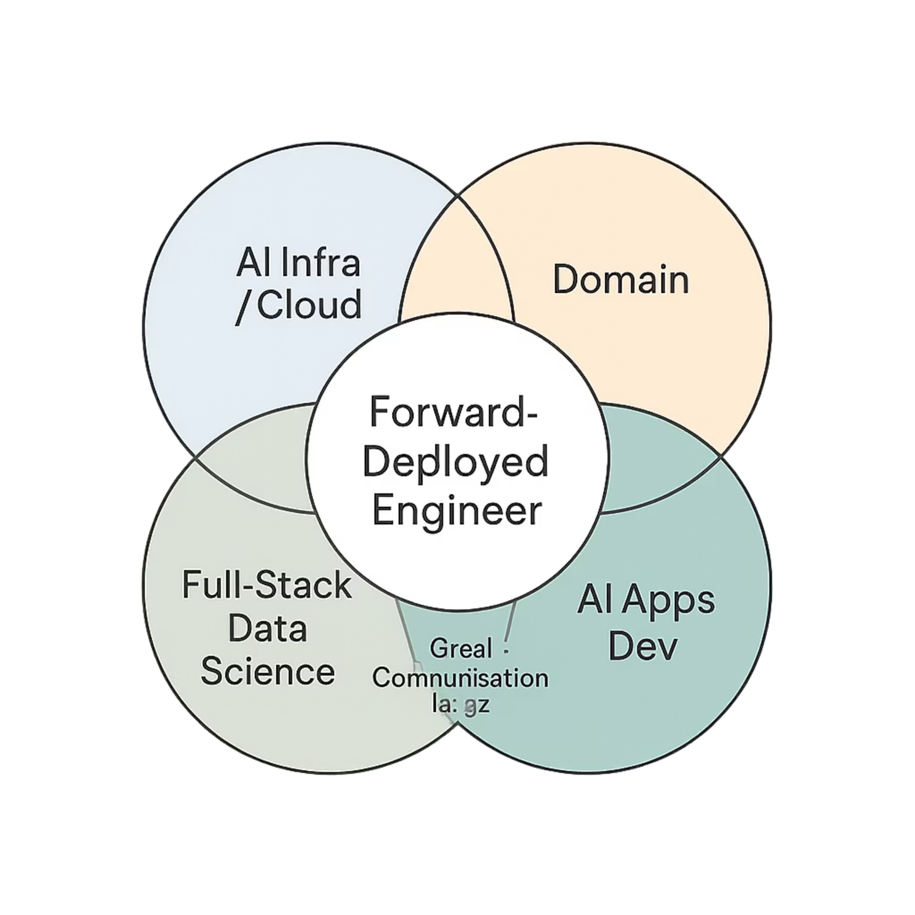
Forward Deployed Engineering (FDE)
Building Real-World AI Solutions
PART 1 — FDE MINDSET
Notes:
“Welcome everyone.
Before we start—this course is very different from traditional AI courses.
This is not a course where we only learn machine learning algorithms.
This is not a course where we only build APIs.
This is not a course where we only call ChatGPT APIs.
This course is about solving real business problems using technology.
In real companies, nobody gives you a clean dataset and says train a model.
Instead they say things like:
‘Customer complaints are increasing’
‘We are spending too much on support’
‘Can we automate this process?’
Your job as an engineer is to convert messy business problems into working technical systems.
That’s what Forward Deployed Engineers do.”
⸻
Key Points:
* Course = problem solving
* Real-world ambiguity
* End-to-end ownership

Slide 2
SLIDE 2 OF 28
What This Course Is About
This is not a traditional coding course, and it is not a machine learning theory class. FDE is about solving real problems end-to-end — combining engineering, design thinking, and AI to deliver working solutions in the real world.
💻 Not Just Coding
🤖 Not Just ML Models
🎯 End-to-End Problem Solving
Syntax and algorithms are only part of the picture. The bigger challenge is knowing what to build.
A trained model is not a solution. Deploying it in context — that's the actual work.
From understanding the business need to shipping a working system — FDE covers the full arc.
Notes:
“Many people learn technologies separately.
They learn:
Python
Machine learning
APIs
LLMs
Frontend tools
But when asked to combine everything into one real solution—they struggle.
Why?
Because knowing tools is different from solving problems.
Throughout this course, we’ll combine backend, AI, data flow, and UI.”
⸻
Key Points:
* Tools ≠ solutions
* Integration matters
* End-to-end thinking

Slide 3

SLIDE 3 OF 28
A Real-World Problem
"We receive over 1,000 emails every day. Our team is overwhelmed. Can AI help us?"
This is the kind of question a Forward Deployed Engineer hears constantly. It sounds simple — but it hides enormous complexity. Before reaching for any tool or technology, you must first understand exactly what is being asked.
Notes:
“Let’s test your instinct.
A company says:
‘We receive 1000 emails daily. Can AI help us?’
What would you do?”
(Pause)
Take student answers.
⸻
After students answer:
“Notice how many of us immediately started discussing technology.
That’s the trap.”
⸻
Key Points:
* Pause before solving
* Gather requirements first

Slide 4
SLIDE 4 OF 28
What Is the Actual Problem?
The client said "AI for emails" — but that phrase means nothing until you dig deeper. One problem statement can hide three completely different engineering challenges. Your first job is to clarify before you build.
📂 Is it Classification?
✉️ Is it Replying?
🔍 Is it Filtering?
Route emails to the right team or department based on content type — billing, support, complaints, general inquiries.
Generate draft responses automatically, letting agents review and send — reducing manual effort per ticket.
Remove spam, duplicates, or low-priority noise so the team focuses only on what truly needs attention.
Each path leads to a fundamentally different architecture, dataset, and success metric.
Notes:
“What does email handling actually mean?
Are we trying to:
Categorize emails?
Auto-reply?
Detect spam?
Route emails to departments?
Same sentence.
Completely different solutions.”
⸻
Key Points:
* Clarify problem
* Avoid assumptions

Slide 5




SLIDE 5 OF 28
COMMON MISTAKE
The Jump-First Trap
When engineers hear an interesting problem, the instinct is to start building immediately. This is one of the most common — and costly — mistakes in applied AI work.
🛠️ Jump to Tools
💻 Start Coding
🤖 Use AI Blindly
Picking a framework or LLM before understanding the problem.
Writing implementation before defining requirements or success criteria.
Assuming AI is the right solution without validating that assumption first.
Momentum without direction wastes time, money, and trust. Slow down to speed up.
Notes:
“Most beginners do this:
Let’s use GPT
Let’s train a model
Let’s build a chatbot
Without understanding the actual business issue.”
⸻
Key Points:
* Tool-first mindset is dangerous

Slide 6
SLIDE 6 OF 28
Why Jumping Ahead Fails
Skipping the problem-definition phase does not just slow you down — it sends you confidently in the wrong direction. Teams that skip this step typically encounter three compounding failures.
The Three Failure Modes
1
No Clarity
These are not edge cases. They are the default outcome when engineers begin with a solution rather than a problem.
The team builds toward a vague target. Different stakeholders have different expectations, and none are met.
2
Wrong Solution
A technically correct system that solves the wrong problem. High effort, zero business value.
3
High Cost
Rework, wasted compute, lost engineering hours — and damaged stakeholder confidence.
Notes:
“Imagine using GPT for every email classification task.
If a company processes millions of emails:
Cost becomes huge.
Sometimes:
simple rules > expensive AI”
⸻
Key Points:
* Wrong architecture
* Higher cost
* Overengineering

Slide 7
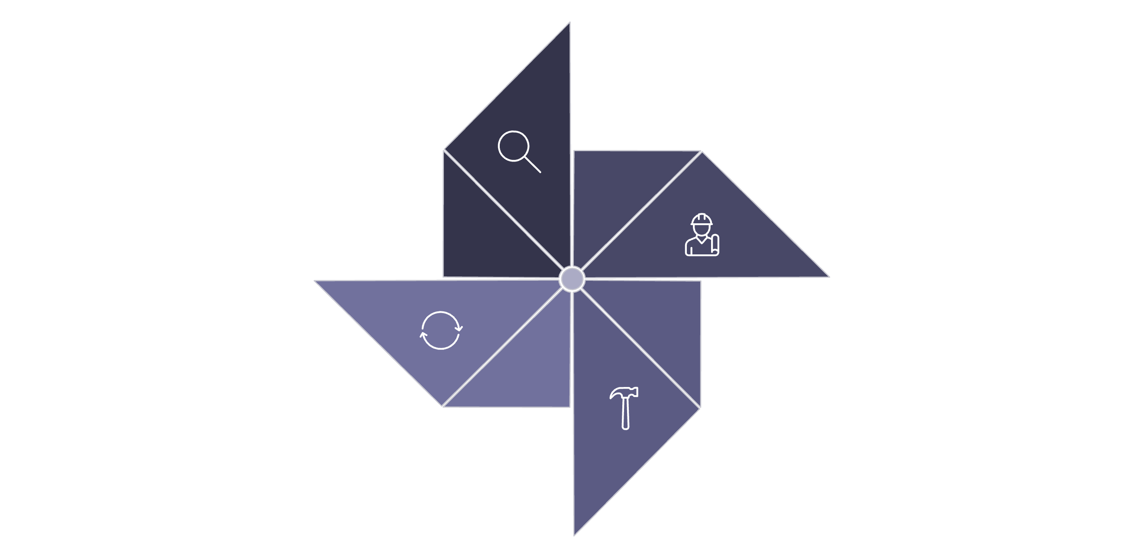

SLIDE 7 OF 28
What Is a Forward Deployed Engineer?
An FDE is not just a coder. They sit at the intersection of engineering, product thinking, and client collaboration. Their defining skill is the ability to move from a messy real-world problem to a working system — quickly and reliably.
Design
Understand
Build
Improve
This loop is not sequential — it is iterative. FDEs cycle through it continuously, compressing time between insight and impact.
Notes:
What to say:
“An FDE understands:
Business
Technology
Execution
So traditionally, Companies used to have coders who knows how to build solutions using technology and also another person who would be a business consultant.
An FDE is a combination of both Business consultant and solution builder who understands technology.
They ask:
What problem exists?
What system solves it?
How quickly can we ship?”
⸻
Key Points:
* Ownership mindset
* Business + technical thinking

Slide 8
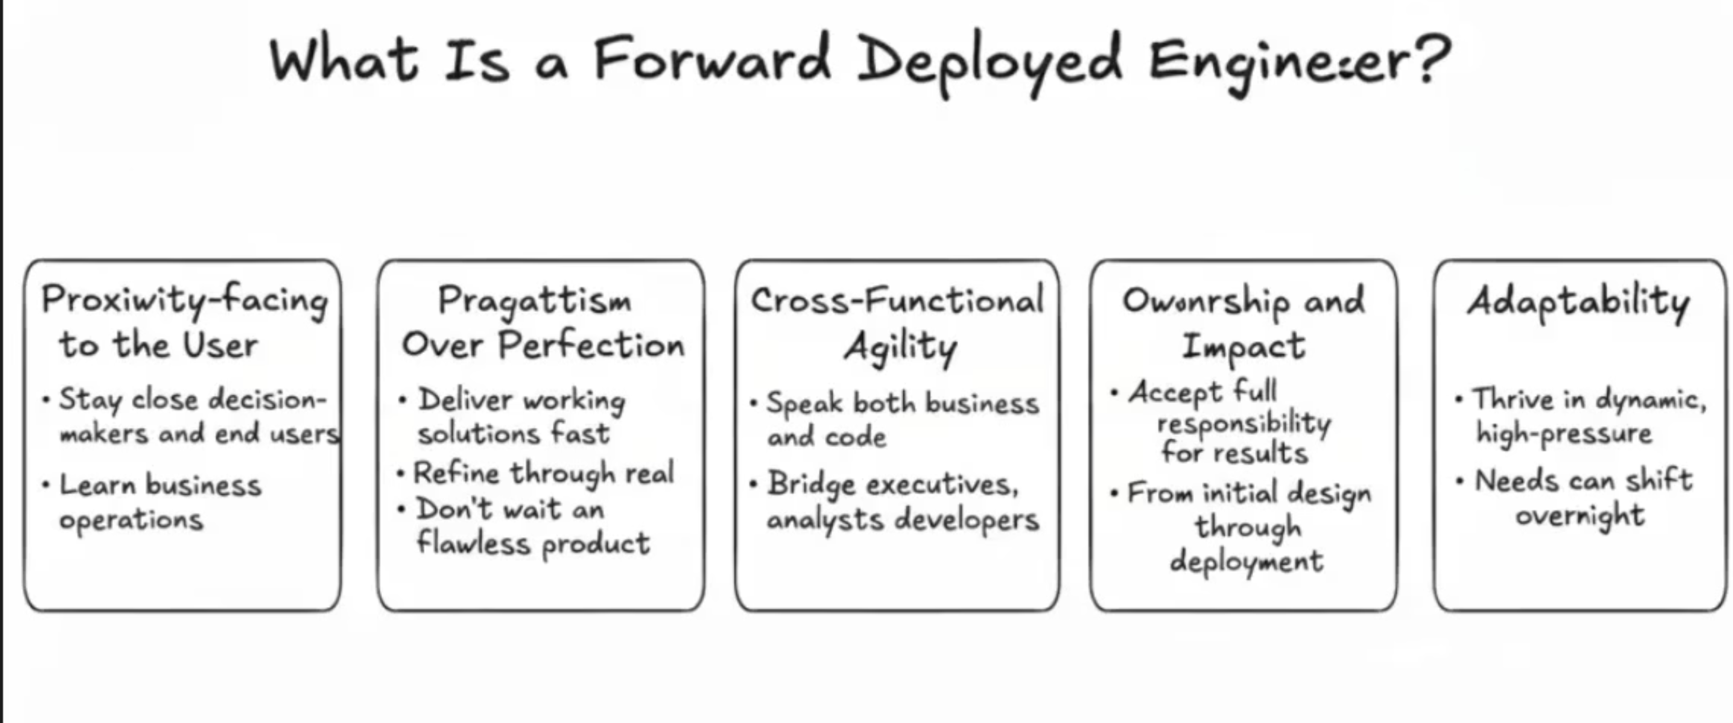

Slide 9
SLIDE 8 OF 28
The FDE Mindset
At its core, FDE is a thinking discipline as much as an engineering practice. The four-phase mindset below governs every project — from a 2-hour prototype to a 6-month production system.
🧠 Think
📐 Design
Define the problem. Identify the real need. Ask why before asking how.
Map inputs, outputs, and constraints. Sketch the system before writing a line of code.
🔨 Build
🔄 Improve
Build the simplest version that delivers value. Speed matters — perfection is the enemy of progress.
Gather real feedback. Measure outcomes. Iterate with purpose, not assumption.
Notes:
“This is your framework:
Think → Design → Build → Improve
This applies throughout the course.”
⸻
Key Points:
* Repeatable framework

Slide 10

PART 2 — PROBLEM BREAKDOWN
SLIDE 9 OF 28
Example Problem
"Build us a chatbot for customer support."
Simple request. Enormous ambiguity. This single sentence could describe dozens of different systems. The FDE's first move is always to resist the urge to build — and instead to ask better questions.
Notes:
“Build a customer support chatbot.
Sounds simple right?
But what does chatbot actually mean?”
Ask students.
⸻
Key Points:
* Problem ambiguity

Slide 11
SLIDE 10 OF 28
Same Problem, Completely Different Solutions
"Customer support chatbot" is not one product — it is a family of products. The right solution depends entirely on who the user is, what pain they have, and what success looks like for the business.
📚 FAQ Bot
😤 Complaint Handling
🎧 Agent Support
Answers common questions using a knowledge base. Best for high-volume, repetitive queries with predictable answers.
Captures, categorizes, and escalates complaints. Requires tone detection and structured routing logic.
Assists human agents in real time — surfacing answers, suggesting responses, and summarizing history.
User: Frustrated customer needing resolution
User: Internal support agent, not the end customer
User: End customer seeking quick answers
Notes:
“One company may need FAQ automation.
Another may need complaint escalation.
Another may need agent support.
Same label.
Different systems.”
⸻
Key Points:
* Context matters

Slide 12
SLIDE 11 OF 28
Before You Build — Three Questions
Every AI system, no matter how complex, can be understood by answering three foundational questions. These are not formalities — they are the blueprint. Skip any one of them and your system will be built on assumptions.
Input
Output
Data
What comes into the system? Define the format, source, and volume of the data the system will receive.
What should the system produce? A label, a response, an action, a score? Nail this before anything else.
What information do we already have? What is the quality, quantity, and structure of available training or retrieval data?
Notes:
“Before building anything ask:
What goes in?
What comes out?
What data do we have?”
⸻
Key Points:
* Input
* Output
* Data

Slide 13
SLIDE 12 OF 28
Input — What Enters the System?
Before designing any processing logic, you must have absolute clarity about what the system receives. The input defines every architectural decision that follows — from preprocessing to model selection.
Questions to Ask
Common Input Types
What format is the data in?
Where does it come from?
How much arrives, and how often?
Is it structured or unstructured?
Does it contain noise or inconsistencies?
Text
Image
Emails, chats, reviews, tickets
Photos, scans, documents
Audio
Structured Data
Call recordings, voice commands
Forms, tables, API responses
Notes:
“Input could be:
Text
Images
Audio
Documents”
⸻
Key Points:
* Identify raw input

Slide 14

SLIDE 13 OF 28
Output — What Should the System Produce?
Defining the output is arguably the most important step in system design. It determines success criteria, evaluation metrics, and the entire shape of your solution. Vague outputs lead to vague systems.
Response
Label / Category
Action
A natural language reply generated for the user — common in chatbots and email drafting systems.
A classification decision — spam vs. not spam, urgent vs. routine, positive vs. negative sentiment.
A trigger or instruction — route to agent, send notification, escalate ticket, archive email.
Pro tip: Write the output spec before designing the model. Work backwards from what you need.
Notes:
“Output may be:
Prediction
Response
Recommendation
Decision”
⸻
Key Points:
* Define success

Slide 15
SLIDE 14 OF 28
Data — What Do We Have to Work With?
Data is the raw material of every AI system. Even the most sophisticated model is only as good as the information it is trained on or retrieves from. Understanding your data early prevents expensive surprises later.
Volume
Quality
How many examples do you have? Is it enough to train, fine-tune, or retrieve from meaningfully?
Is the data labeled? Is it clean, consistent, and representative of real-world conditions?
Availability
Structure
Is the data accessible right now? Are there legal, privacy, or access restrictions to navigate?
Is it organized in a format your system can ingest, or does it require significant preprocessing work?
Notes:
“No data = no system.
Or bad data = bad system.”
⸻
Key Points:
* Data quality

Slide 16
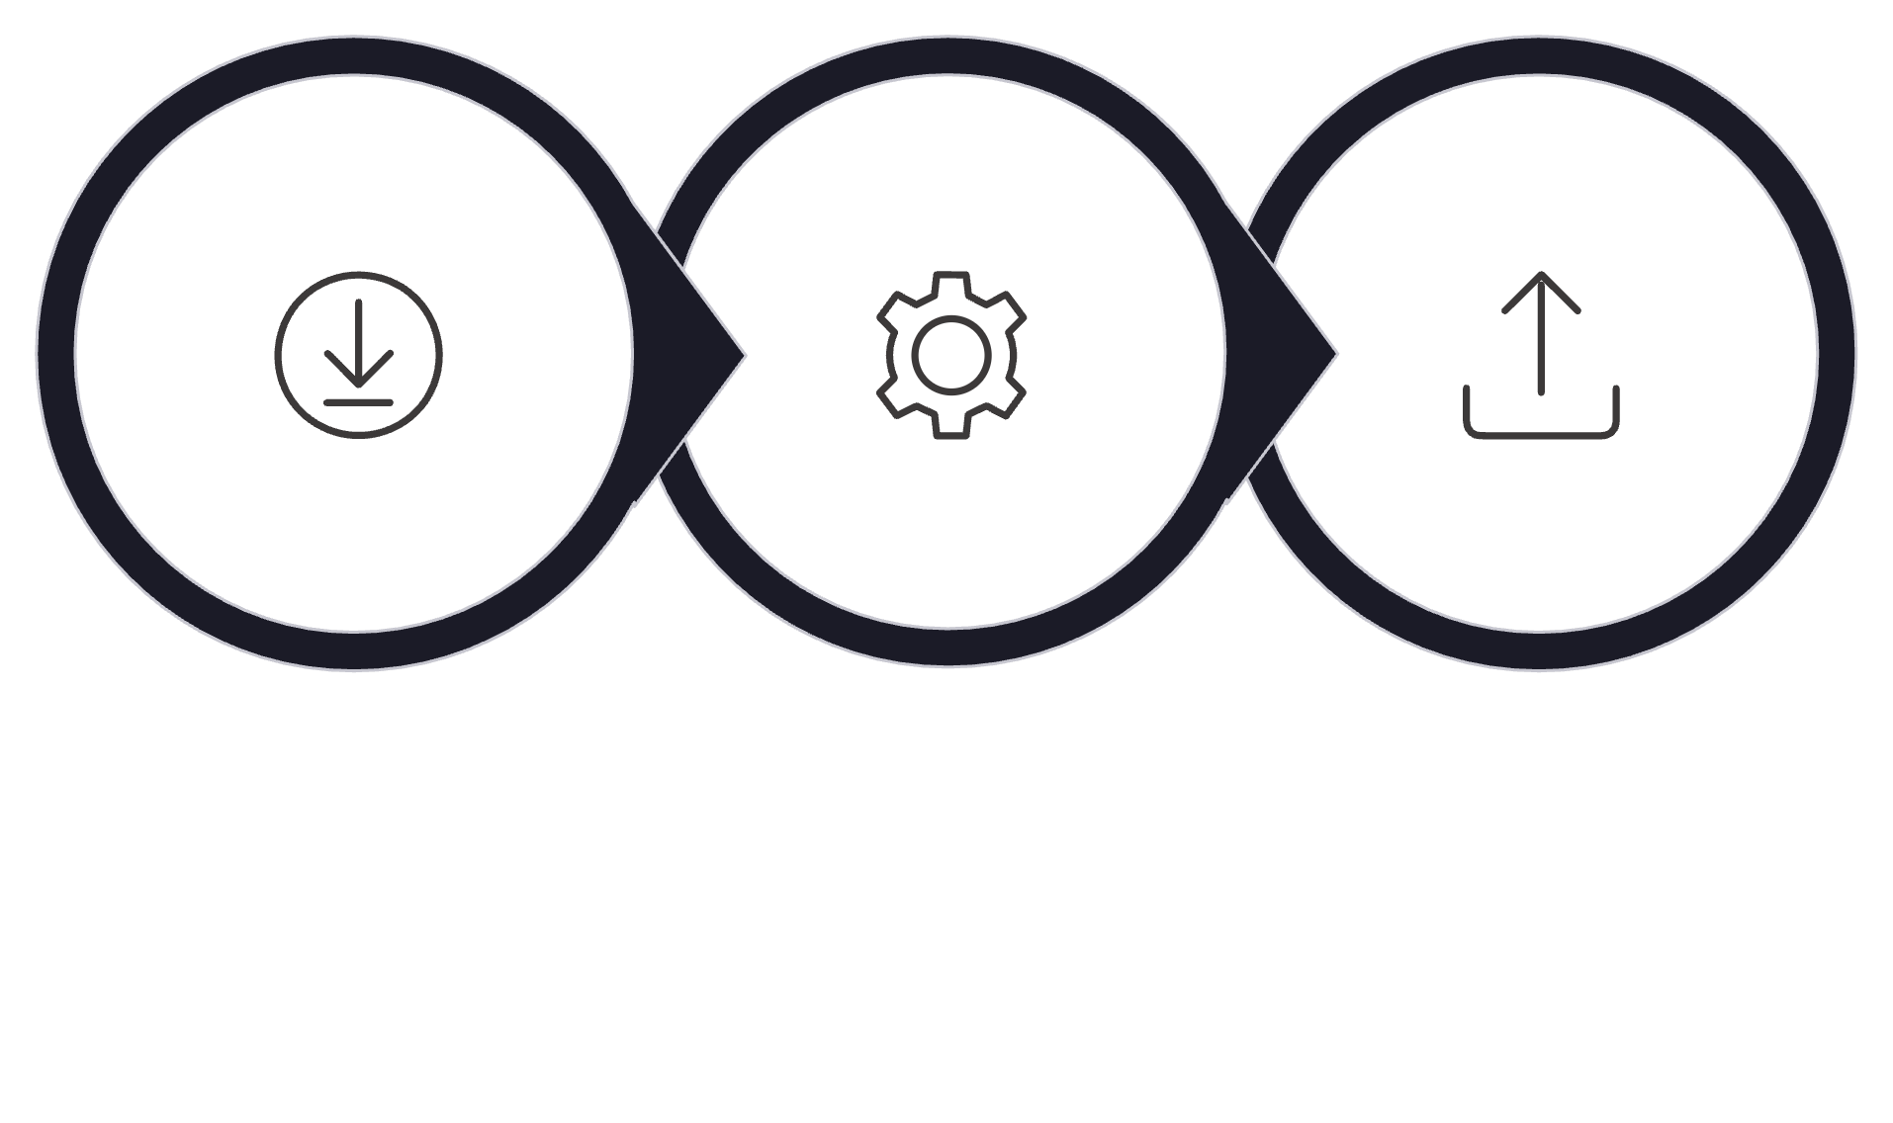
SLIDE 15 OF 28
The Core Model of Any System
Strip away the complexity of any AI system and you will find the same fundamental structure underneath. This three-part model is the universal framework for thinking about what a system does and how it works.
Input
Processing
Output
Every design decision you make maps to one of these three layers. When something breaks, you trace it back to one of them. This mental model keeps complex systems manageable.
Notes:
“This is probably the most important slide today.
Every system can be simplified into:
Input → Processing → Output”
⸻
Key Points:
* Core mental model

Slide 17
SLIDE 16 OF 28
The Processing Layer — Three Approaches
The processing layer is where the real engineering decisions live. Not every problem needs AI — and choosing the right approach for the right situation is a core FDE competency.
Rules
1
Hand-coded logic — if/else conditions, keyword matching, regex. Fast, predictable, and fully explainable. Best for simple, stable problems.
ML Models
2
Trained on labeled data to generalize patterns. Handles complexity and scale that rules cannot — but requires data and tuning.
AI / LLMs
3
Large language models for open-ended tasks — generation, reasoning, summarization. Powerful, but costly and harder to control.
Start with the simplest approach that solves the problem. Add complexity only when the simpler approach provably falls short.
Notes:
“Inside processing:
Rules
Machine learning
LLMs
Databases
Decision logic”
⸻
Key Points:
* AI is optional

Slide 18

SLIDE 17 OF 28
Constraints — The Hidden Architecture
Every system operates within real-world constraints. These are not obstacles to work around — they are inputs to your design. Ignoring them produces technically elegant systems that cannot be deployed or sustained.
Time
Cost
Accuracy
How fast must the system respond? Real-time inference has very different architecture needs than batch processing.
What is the per-query or per-month budget? API calls, compute, and storage all add up — often faster than expected.
What error rate is acceptable? A medical diagnostic tool and a playlist recommender have very different tolerance thresholds.
Map your constraints at the start of every project. They will save you from building the right solution for the wrong context.
Notes:
“In companies:
Time matters
Budget matters
Accuracy matters”
⸻
Let the students answer
Example:
Medical AI needs accuracy.
Startup MVP needs speed.
⸻
Key Points:
* Constraints shape architecture

Slide 19
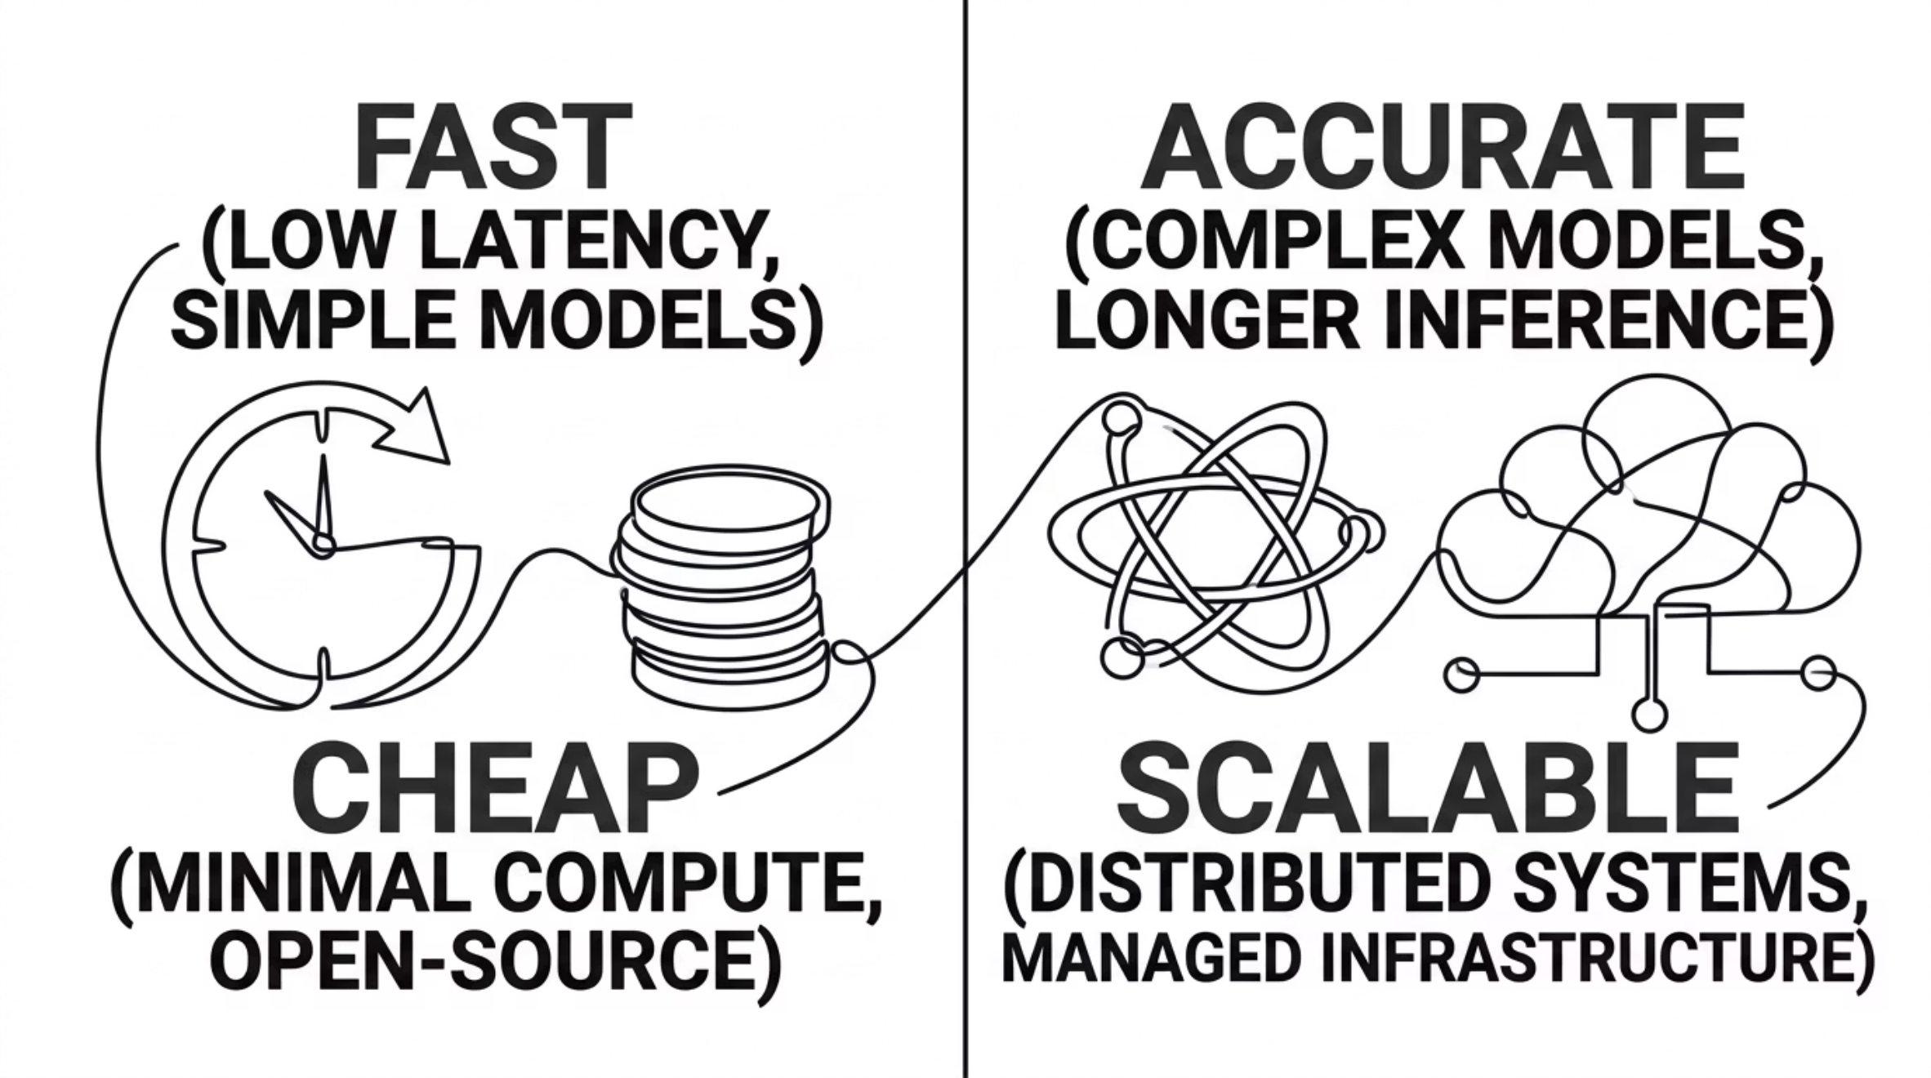

SLIDE 18 OF 28
Trade-offs — There Is No Perfect System
Every design decision in AI engineering involves a trade-off. Understanding these tensions — and making conscious, justified choices — is what separates a skilled FDE from a junior engineer who optimizes blindly.
The goal is not to win every trade-off — it is to make the right trade-off for your specific context, constraints, and users.
Notes:
“There’s no perfect solution.
Every decision sacrifices something.”
⸻
Key Points:
* Trade-offs

Slide 20
SLIDE 19 OF 28
Key Insight
Solve the problem.
Don't over-engineer.
The most dangerous engineer is not the one who builds too little — it is the one who builds too much. Over-engineered systems are harder to maintain, harder to explain, and often no more effective than a simpler alternative.
✅ The Right Standard
⚠️ The Wrong Standard
Does this system reliably solve the problem it was designed to solve? If yes, ship it.
Is this technically impressive? Does it use the most advanced model available? These are vanity metrics — not success criteria.
Notes:
“Your goal is not building impressive systems.
Your goal is solving business problems.”
⸻
Key Points:
* Solve > impress

Slide 21
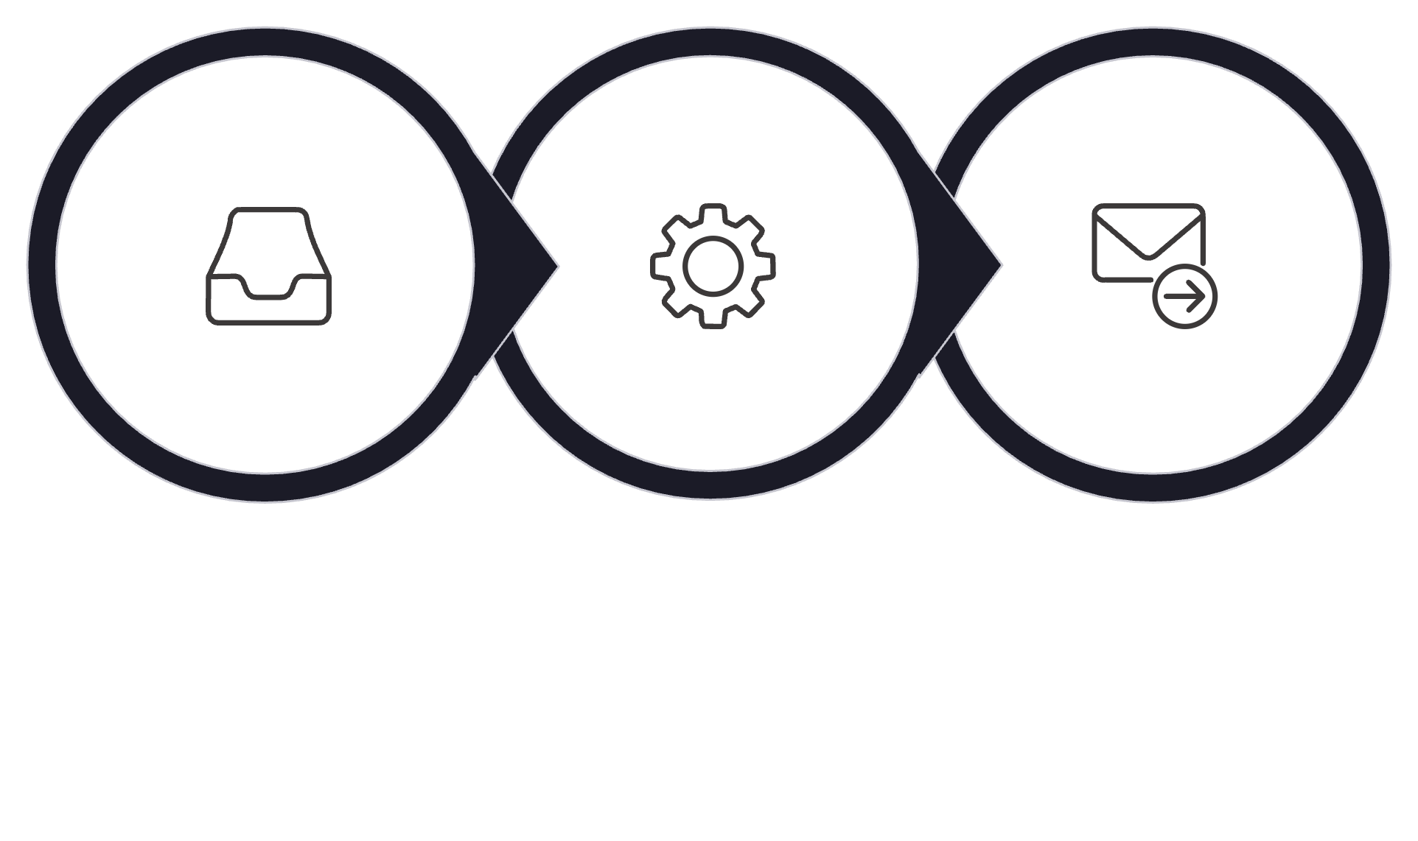
PART 3 — SYSTEM THINKING
SLIDE 20 OF 28
Every System Looks Like This
Whether you are building a document classifier, a recommendation engine, or a real-time translation service — every AI system at its core follows the same universal pattern. Internalizing this model makes even the most complex systems approachable.
Input
Processing
Output
This is not a simplification — it is the foundational lens through which FDEs analyze, design, and debug every system they encounter.
Notes:
“Food delivery app?
Same framework.
Netflix recommendation?
Same framework.
Everything follows input → processing → output.”
Key Points:
* Universal pattern

Slide 22

SLIDE 21 OF 28
Example System — End-to-End Pipeline
Let's make the abstract concrete. Here is how a real AI-powered support system maps to the universal model — four components, each with a clear role and interface.
User Input
Backend
AI Model
User Response
Each arrow in this diagram represents an interface — a contract between components. FDEs think carefully about what flows across each boundary: format, latency, failure modes, and fallback behavior.
Notes:
“This is what we’ll build in this course:
User → Backend → AI → Response”
Key Points:
* Course roadmap

Slide 23
SLIDE 22 OF 28
System Components — What Makes a System
A production AI system is never just a model. It is a collection of components that each play a specific role. Understanding this architecture prevents the "just call the API" misconception that causes most real-world deployment failures.
Backend
Logic
Handles requests, authentication, routing, and orchestration. The backbone of the system.
Business rules, conditional processing, and decision trees that control system behavior.
Data
UI
Persistent storage, retrieval systems, knowledge bases, and training data pipelines.
The surface through which users interact — web app, API, chat widget, or dashboard.
Notes:
“Backend handles requests
Logic makes decisions
Data stores information
UI interacts with users”
⸻
Key Points:
* Full stack view

Slide 24
SLIDE 23 OF 28
Where AI Fits in the System
One of the most important mental shifts for engineers new to AI is this: AI is a component, not a system. It lives inside the processing layer — doing specific things that rules and logic cannot do well — but it is never the whole solution.
The Key Principle
Input Layer
AI does not replace your system — it enhances the processing layer. The rest of the system is still your responsibility as an engineer.
Handles ingestion, validation, and formatting of raw data before it reaches the model.
→ AI Lives Here ←
The model processes transformed input and returns predictions, text, or structured outputs.
Output Layer
Post-processing, formatting, safety filtering, and delivery of the final result to the user.
Notes:
“AI is one layer—not the entire product.”
AI does not replace your system — it enhances the processing layer. The rest of the system is still your responsibility as an engineer.
⸻
Key Points:
* AI is just a component

Slide 25
SLIDE 24 OF 28
COMMON MISTAKE
"Let's Use AI" ≠ Solution
"Let's add AI to it."
This is one of the most common — and most expensive — phrases in modern tech. AI is not a magic layer you add to make a product better. It is a specific tool for specific problems, with real costs, real failure modes, and real maintenance overhead.
❌ Wrong Question
✅ Right Question
"How can we use AI here?" — starts with the technology, not the problem.
"What is the problem — and is AI the most appropriate tool to solve it?" — starts with the outcome.
AI for its own sake produces impressive demos and expensive failures. Always justify the tool choice with the problem.
Notes:
“Many startups say:
‘Let’s use AI’
That’s not strategy.”
⸻
Key Points:
* AI hype trap

Slide 26
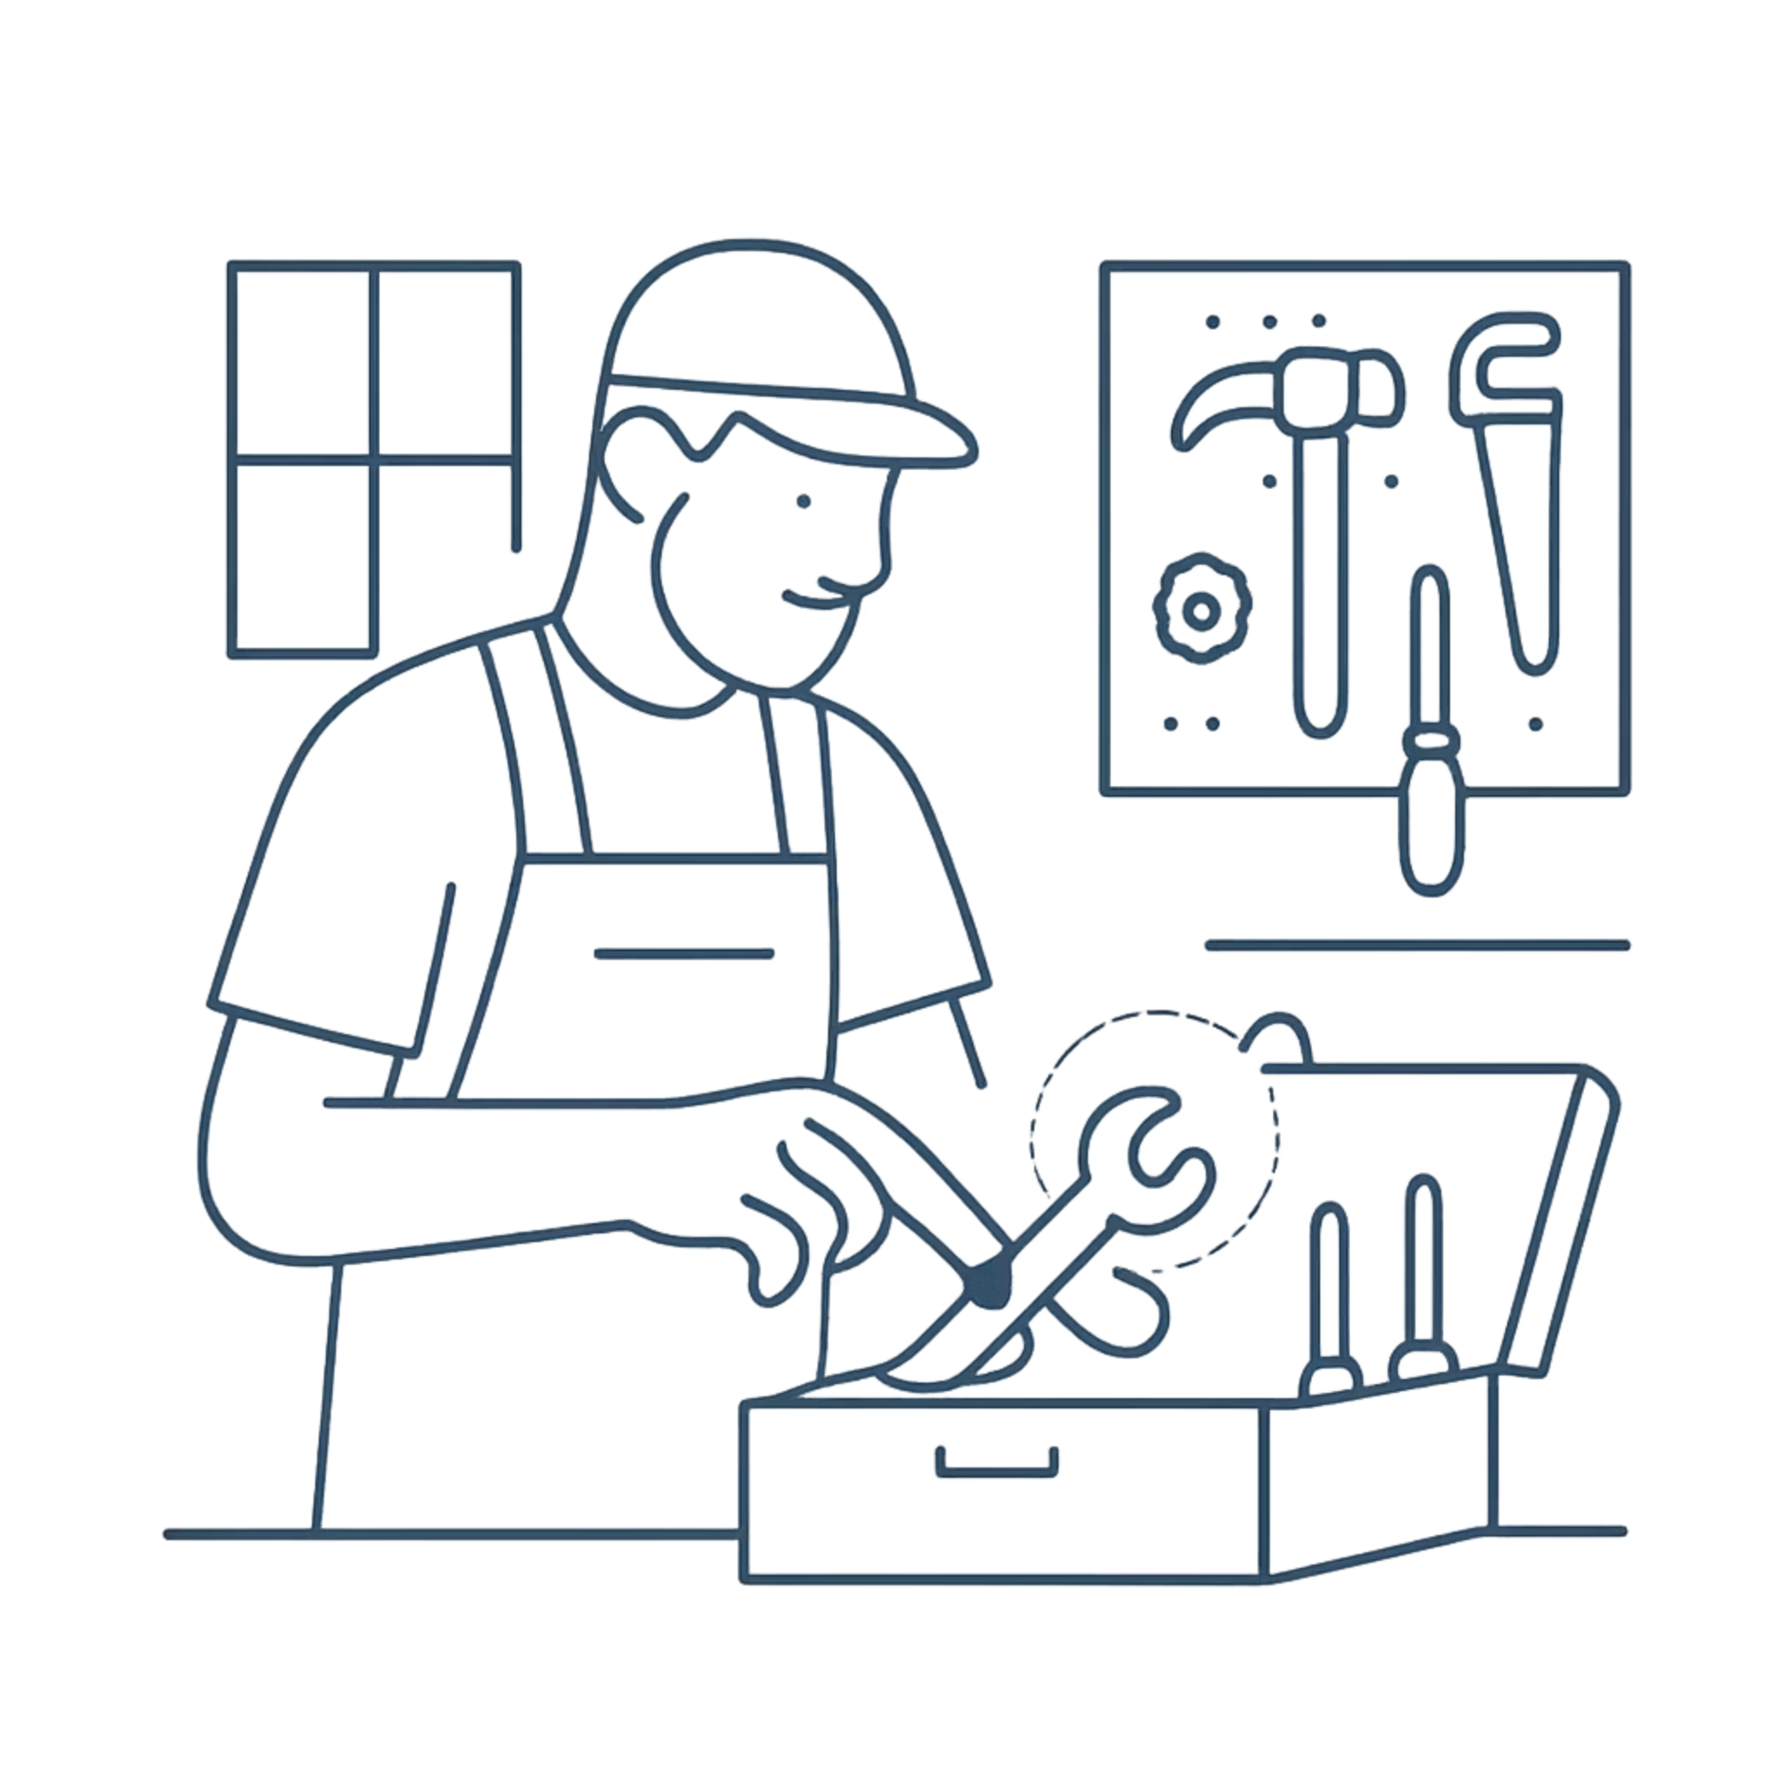
SLIDE 25 OF 28
The Right Approach — Use the Right Tool
A skilled FDE is not an AI maximalist. They are a pragmatist. Their job is to find the simplest, most reliable solution that solves the problem — even if that solution is a spreadsheet, a rule, or a simple lookup table.
Define the problem precisely
Evaluate your options
What exactly needs to happen? Who is the user? What does success look like?
Rules, ML, LLM, or hybrid? Consider speed, cost, accuracy, and maintenance burden.
Choose the simplest viable solution
Start there. Upgrade only when you have evidence — not assumptions — that more complexity is needed.
Notes:
“Choose tools based on business needs.”
⸻
Key Points:
Right tool selection

Slide 27
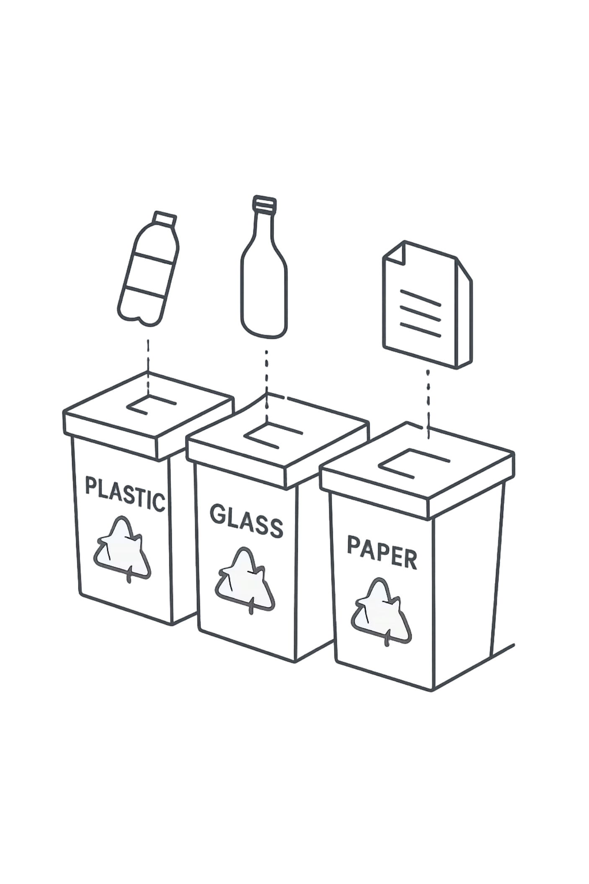
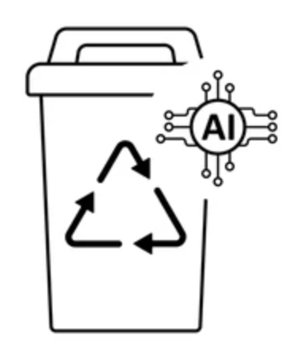
PART 4 — INTERACTIVE CASE
SLIDE 26 OF 28
Case Study — Electronic Waste Recycling Classification System
“A company wants to build a solution that identifies the product in the image which is later used for recycling..”
This is a real-world problem that touches image recognition, user experience, data availability, and deployment constraints. Before discussing any technology, let's apply the FDE mindset and break it down systematically.
Notes:
“Let’s solve something together.
Build a waste recycling classification system.
This is a real-world problem that touches image recognition, user experience, data availability, and deployment constraints. Before discussing any technology, let's apply the FDE mindset and break it down systematically.
⸻
Ask:
“What happens first?”
“What’s the input?
What’s processing?
What’s output?”
Let students think.
⸻
Key Points:
* Apply concepts

Slide 28

SLIDE 27 OF 28
Think First — Apply the Framework
Using the waste classification case, work through the three core questions before writing a single line of code. This exercise builds the habit that separates good engineers from great ones.
1
2
3
What is the Input?
What is the Output?
What is the Processing?
A photo taken by a user's phone camera — raw image data, varying lighting, angles, and backgrounds. Possibly also text descriptions as a fallback.
A product category label: Fridge, Washing Machine, TV, Remote, or Hazardous — plus a confidence score and actionable disposal instruction.
An image classification model — likely a fine-tuned CNN or vision model — trained on labeled waste images. It can also be a multimodal AI model. Preprocessing and fallback logic required.
Bonus question: What constraints matter here? Consider: offline use, low-end devices, user trust, and regulatory requirements by region.
Notes:
Talk about the slides
Key Points:
* Structured thinking

Slide 29
SLIDE 28 OF 28
Final Takeaway
Think first.
Build next.
This is the FDE ethos in two words. The best engineers are not the fastest to open their code editor — they are the clearest thinkers before they do. Every hour spent defining the problem correctly saves days of rework later.
🧠 Think
🛠️ Build
🔄 Iterate
Define the real problem. Map inputs, outputs, and constraints before touching any technology.
Choose the simplest viable tool. Build fast, stay focused, and measure what matters.
Use real feedback to improve. The first version is never the last — and that is by design.
Notes:
“If you remember one thing from today:
Think first.
Build next.”

